Slide 1





8 WEEKSQL CHALLENGE

Slide 2
TABLE OF CONTENTS
01
02
03
04
05
INTRODUCTION
PROBLEM STATEMENT
ENTITY RELATIONSHIP DIAGRAM
DATASETS
INSIGHTS

Slide 3


INTRODUCTION
Danny loves Japanese food and in early 2021, he opened a small restaurant called Danny’s Diner. He serves his three favorite dishes: sushi, curry, and ramen. However, running the restaurant has been challenging, and Danny needs help to keep it going. Although he has collected some basic data from the first few months of operation, he isn't sure how to use it to improve his business. That’s where we come in! Our goal is to analyze this data to provide insights and strategies that will help Danny’s Diner thrive.

Slide 4

PROBLEM STATEMENT
Danny wants to leverage his restaurant’s data to better
understand his customers. Specifically, he aims to uncover
insights about their visiting patterns, spending habits, and
favorite menu items. This understanding will enable Danny
to enhance customer experiences with personalized
services.
Furthermore, Danny seeks assistance in evaluating whether
to expand his current customer loyalty program based on
these insights. To facilitate easy data analysis for his team,
he needs basic datasets prepared without requiring SQL
expertise.

Slide 5


For this case study, Danny has provided three essential datasets: i. sales ii. menu iii. members These datasets offer a snapshot of customer behavior and preferences, which will be used to formulate SQL queries to address Danny’s questions effectively.

Slide 6
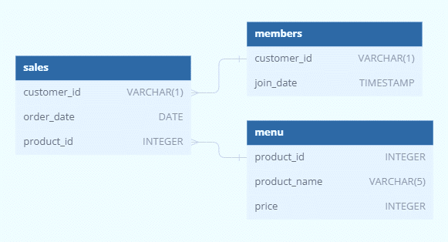

ENTITY RELATIONSHIP DIAGRAM

Slide 7

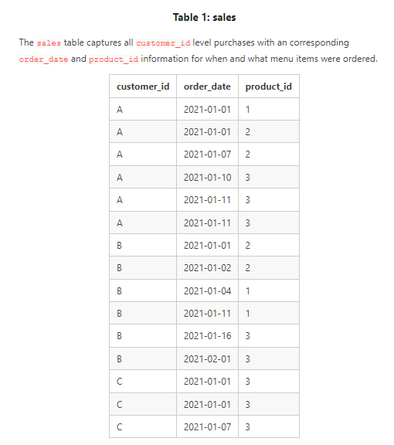
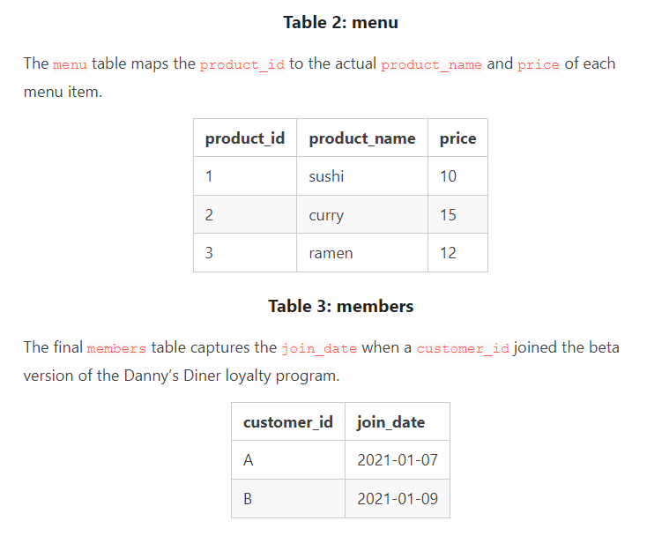
DATASETS

Slide 8

FINDING INSIGHTS USING SQL QUERIES

Slide 9
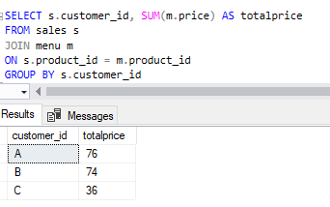
1. What is the total amount each customer spent at the restaurant?

Slide 10
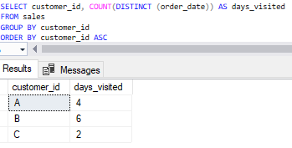
2. How many days has each customer visited the restaurant?

Slide 11
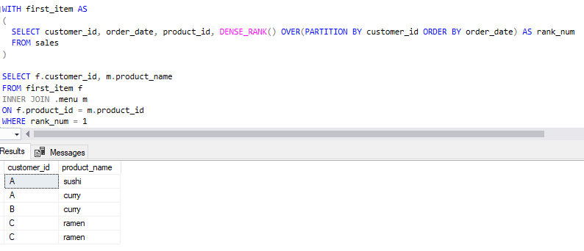
3. What was the first item from the menu purchased by each customer?

Slide 12
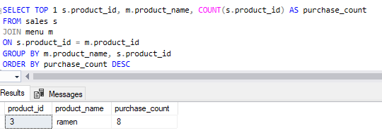
4. What is the most purchased item on the menu and how many times was it purchased by all customers?

Slide 13
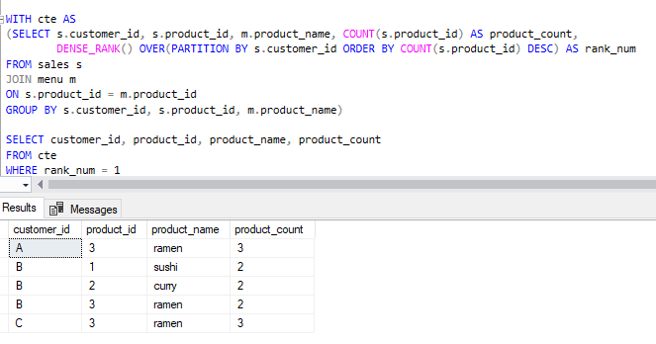
5. Which item was the most popular for each customer?

Slide 14
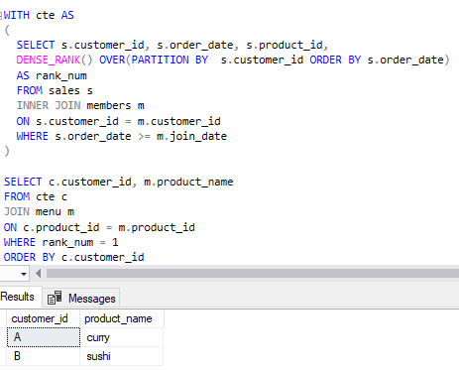
6. Which item was purchased first by the customer after they became a member?

Slide 15
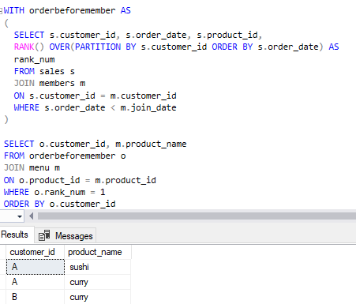
7. Which item was purchased just before the customer became a member?

Slide 16
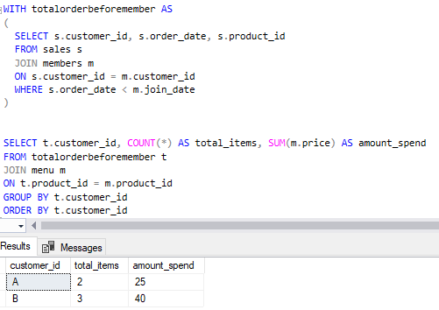
8. What is the total items and amount spent for each member before they became a member?

Slide 17
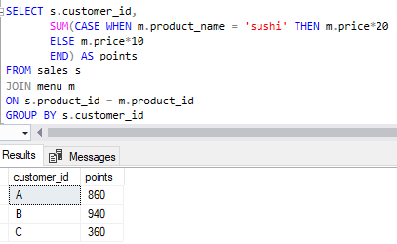

9. If each $1 spent equates to 10 points and sushi has a 2x points multiplier - how many points would each customer have?

Slide 18
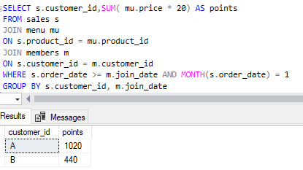
10. In the first week after a customer joins the program (including their join date) they earn 2x points on all items, not just sushi - how many points do customer A and B have at the end of January?

Slide 19
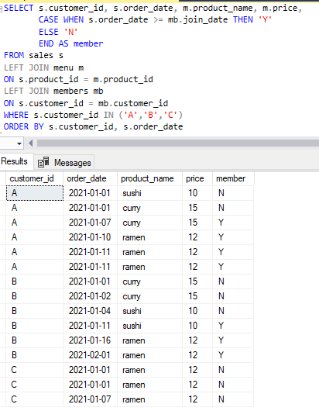
BONUS QUESTIONS – JOIN ALL THE THINGS

Slide 20
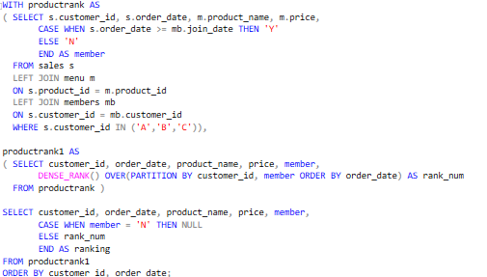
BONUS QUESTIONS – RANK ALL THE THINGS

Slide 21
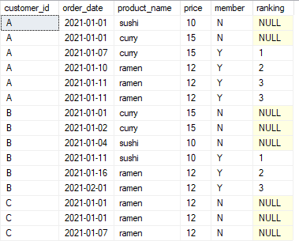

Slide 22
Key Insights from the Case Study
Customer A spent the most at the restaurant, totaling $76, followed by Customer B with $74, and Customer C with $36.
Customer B visited the restaurant the most frequently.
Ramen is the most purchased item on the menu.
Customer B has the highest loyalty points with 940, followed by Customer A with 860, and Customer C with 360.

Slide 23
THANKS!

